Slide 1
Updates from
Warwickshire County Council

Slide 2
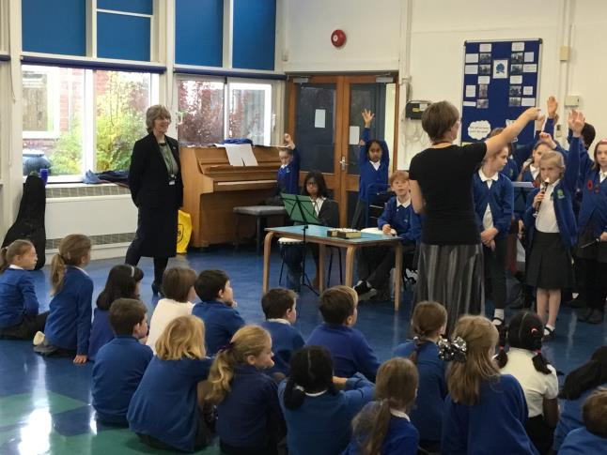
Chris Malone
Assistant Director, Education Services

Slide 3
Paul Senior
Interim AD - Education services
Story and Journey to Warwickshire….
Priorities/ Focus:
Partnerships
Policy
Performance
Strategy
Key Deliverables

Slide 4
Peter Kent
Education Strategy Champion for Warwickshire County Council

Slide 5
Hayley Good
Strategic Lead, Learning & Performance WCC
DfE School Improvement announcements last Friday
OFSTED ethical inclusion research project
MOU Review
Warwickshire Attendance service
Targeted governor training offer
WISP (Warwickshire Improving SEND Project)
Learning and Performance - hayleygood@warwickshire.gov.uk

Slide 6
Ross Caws
SEND & Inclusion
Consultation on draft SEND & Inclusion Strategy
Promoting Inclusion
Delivering Outcomes for School Age Learners with High Needs
Improving health and social care outcomes for learners with SEND
Preparation for Adulthood
Workforce Development
Transport
Engagement on review of SEN Provision Matrix
Savings plan of £1.5m from High Needs Block shared with Schools Forum
SEND and Inclusion - rosscaws@warwickshire.gov.uk

Slide 7
John Edwards
Strategic Lead - Education Sufficiency and Access
Strong demand from working parents for 30 hours Childcare for 3 and 4 year olds.
The Council's Sufficiency Strategy is now published and available at: https://apps.warwickshire.gov.uk/api/documents/WCCC-1023-88 or through the Education Strategy at: https://www.warwickshire.gov.uk/educationstrategy
We continue to implement changes to the Council's Home to School Transport policy.
School admissions arrangements for September 2020 will be out for consultation in December.
Education Sufficiency and Access – johnedwards@warwickshire.gov.uk

Slide 8
Deena Moorey
Virtual School for Children Looked After (CLA) and
Children Previously Looked After (CPLA)
1. Statutory duty regarding CLA and CPLA
DT training update
Senior Teacher requirement
CLA returning to parents are not CPLA
2. Opportunities for CLA
Choir in a day, 21st Nov
University Go!
3. Opportunities for schools
Spring term SEMH training in Heads Up
Attachment Aware Schools project
Virtual School – deenamoorey@warwickshire.gov.uk

Slide 9
Thank you
for coming!
We value your feedback, please fill in
the evaluation form in your pack and
leave on your table for collection.

