Slide 1
Key Note Speaker
Sir John Dunford

Slide 2
Raising achievement and closing gaps: using the pupil premium effectively
Autumn Headteachers’ Conference
Warwickshire
15 November 2018
John Dunford

Slide 3
Raising achievement and closing the gap: the priorities
Raising achievement
and
Closing the gap
Excellence
and
Equity

Slide 4
Attainment
PP pupils
Other pupils
Time

Slide 5
Current strategies: maximum impact
What PP strategies are making the greatest impact in your school?

Slide 6
Gap and disadvantaged attainment at 11, 2017
 | Gap at 11 | PP/NPP |  | Gap at 11 | PP/NPP
Birmngham | 16 | 49 / 65 | Stoke | 15 | 48 / 63
Coventry | 17 | 48 / 65 | Walsall | 25 | 39 / 64
Dudley | 27 | 38 / 63 | Warwks | 26 | 42 / 68
Sandwell | 15 | 49 / 64 | Wolvhmpton | 18 | 50 / 68
Solihull | 21 | 49 / 70 | Worcester | 26 | 38 / 64
Staffs | 21 | 48 / 69 | National | 20 | 48 / 68

Slide 7
Gap and disadvantaged attainment at 16, 2017
pp
 | Gap at 16 | PP/NPP |  | Gap at 16 | PP/NPP
Birmngham | -0.33 | -0.18 / 0.15 | Stoke | -0.45 | -0.38 / 0.07
Coventry | -0.45 | -0.43 / 0.02 | Walsall | -0.61 | -0.62 / -0.01
Dudley | -0.54 | -0.51 / 0.03 | Warwks | -0.62 | -0.45 / 0.17
Sandwell | -0.37 | -0.39 / -0.02 | Wolvhmpton | -0.48 | -0.34 / 0.14
Solihull | -0.56 | -0.55 / 0.01 | Worcester | -0.62 | -0.52 / 0.10
Staffs | -0.51 | -0.53 / -0.02 | National | -0.51 | -0.40 / 0.11

Slide 8
Missing talent
Sutton Trust report, June 2015. Key findings:
15% of highly able pupils who score in the top 10% nationally at age 11 fail to achieve in the top 25% at GCSE
Boys, and particularly pupil premium eligible boys, are most likely to be in this missing talent group
Highly able pupil premium pupils achieve half a grade less than other highly able pupils, on average, with a very long tail to underachievement
Highly able pupil premium pupils are less likely to be taking GCSEs in history, geography, triple sciences or a language
http://www.suttontrust.com/researcharchive/missing-talent/

Slide 9
Looked-after children: some statistics
68% of looked-after children achieved level 4 in reading, compared with 89% of others.
The gap at 11 is even larger in writing and mathematics.
12% of looked-after children achieved 5+ GCSEs at A*-CEM, compared with 53% of others.
33% of care leavers become NEET, compared with 13% of all young people.
6% of care leavers go to university, compared with 40% of others.
This is less than the percentage of care leavers who go to prison.
67% of looked-after children have SEN cf. 18% of the total population. Of those, 29% have a statement cf. 2.8% of all children.
62% of children become looked-after as a result of abuse or neglect and they have a much higher incidence of mental health problems.
Looked-after children especially need our additional support to achieve their potential and improve their life chances.

Slide 10
Focus for the pupil premium
The gap: Decide on comparators for PP students
PP / Non-PP in your school
PP in your school / Non-PP pupils nationally
Other forms of disadvantage
What is your ambition?
In 10% of schools nationally, FSM attainment is above the national average for ALL pupils
Use evidence of what works
Improve transition, especially for disadvantaged
Focus relentlessly on the quality of teaching and learning

Slide 11
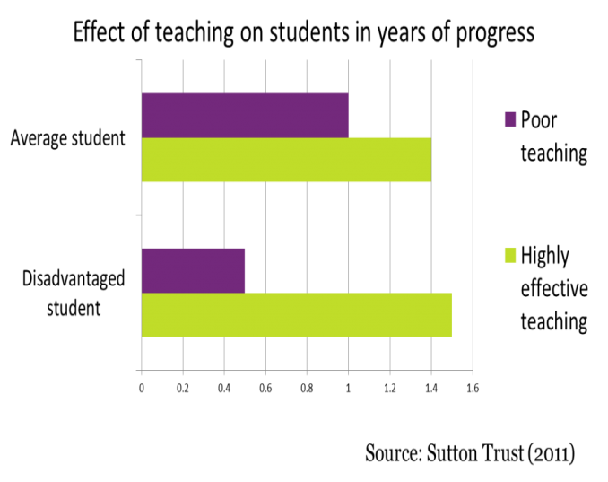

Slide 12
The over-riding importance of quality first teaching
Focus relentlessly on the quality of teaching and learning
Improve transition, especially for disadvantaged
Spend some PP on raising the quality of teaching and engaging disadvantaged pupils in their learning, e.g. feedback, metacognition
Improve the impact of 1:1 and small group work

Slide 13
Overcoming the barriers
Identify barriers to learning for PP pupils
Decide your desired outcomes
Identify success criteria for each outcome
Choose your PP strategies
Implement strategies with in-depth training
Evaluate strategies regularly
Tell the story: create an audit trail

Slide 14
Identifying the barriers to learning for PP pupils
What are the barriers to learning for your PP pupils?

Slide 15
Identifying the barriers to learning for PP pupils through ….
Learning walks
PP student shadowing
PP student voice
Achievement and attendance analysis
Parent views
SLT, staff and governor views

Slide 16
Turning aims into impact
Establish the school’s desired outcomes
Set success criteria for each of these
Hold yourselves to account for the impact

Slide 17
Deciding your desired outcomes
Desired outcomes | Success criteria
Improving FSM attainment
Reducing gaps
Improving attendance
Accelerating progress
Reducing exclusions
Improving behaviour
Improving engagement of families
Developing skills and personal qualities
Extending opportunities
Improving transition
Good destination data

Slide 18
Choosing your school strategies
What strategies will produce these desired outcomes and help you to achieve your success criteria?
“Individual need, classroom rigour”
Use evidence of what works
In-depth staff training on chosen strategies

Slide 19
Evaluating your school strategies
External review and school self-review are both important
Evaluate impact of strategies
http://tscouncil.org.uk/guide-effective-pupil-premium-reviews/
Compare your school’s PP performance with like schools http://educationendowmentfoundation.org.uk/toolkit/families-of-schools/

Slide 20
A clear audit trail on the school website
 | Person responsible | Cost | Evaluation | Impact
Improve feedback
1:1 tuition
Attendance officer
Peer tutoring
etc
Plus case studies of impact on (anon) individual pupils
How good is the PP audit trail in your school?

Slide 21
Use evidence to choose the best strategies for your school
To support individuals in overcoming barriers to learning
To improve the quality of teaching, learning and assessment

Slide 22
The opportunity
Schools should not wait for politicians to tell you what to do with the pupil premium
The government isn’t telling schools how to close the gap
It’s for schools to decide how to use PP
Stop looking up and start looking out

Slide 23
The evidence of what works elsewhere
Seek out excellent practice in other schools www.pupilpremiumawards.co.uk
Study local, regional, national international evidence
Use the Education Endowment Foundation toolkit https://educationendowmentfoundation.org.uk/resources/teaching-learning-toolkit
Use published reports:
the NFER report on success and good practice
www.nfer.ac.uk/publications/PUPP01
Ofsted surveys http://www.ofsted.gov.uk/resources/pupil-premium-how-schools-are-spending-funding-successfully-maximise-achievement
https://johndunfordconsulting.co.uk/blog/ August 2015

Slide 24
EEF Toolkit Strategies
Arts participation
Aspiration interventions
Behaviour interventions
Block scheduling
Collaborative learning
Digital technology
Early years intervention
Extending school time
Feedback
Homework (Primary)
Homework (Secondary)
Individualised instruction
Learning styles
Mastery learning
Mentoring
Meta-cognition and self-regulation
One to one tuition
18. Oral language interventions
19. Outdoor adventure learning
20. Parental involvement
21. Peer tutoring
22. Performance pay
23. Phonics
24. Physical environment
25. Reading comprehension strategies
26. Reducing class size
27. Repeating a year
28. School uniform
29. Setting or streaming
30. Small group tuition
31. Social and emotional learning
32. Sports participation
33. Summer schools
34. Teaching assistants

Slide 25
EEF Toolkit Strategies
LOW IMPACT HIGH COST
HIGH IMPACT HIGH COST
LOW IMPACT LOW COST
HIGH IMPACT LOW COST

Slide 26
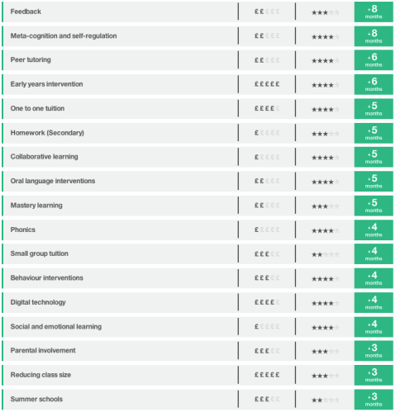
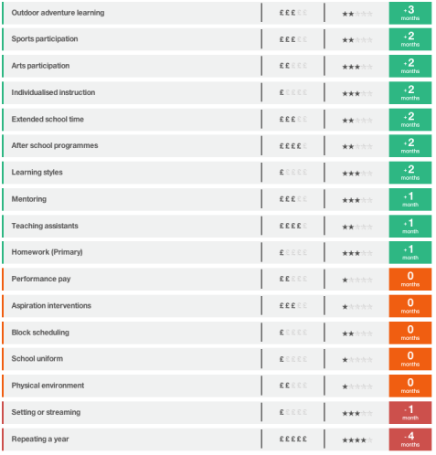
EEF Toolkit

Slide 27
Using teaching assistants effectively
The DISS project: Deployment and Impact of Support Staff www.oxfordprimary.co.uk
http://fdslive.oup.com/www.oup.com/oxed/primary/literacy/osi_teaching_assistants_report_web.pdf?region=uk
EEF report on Making Best Use of Teaching Assistants http://educationendowmentfoundation.org.uk/uploads/pdf/TA_Guidance_Report_Interactive.pdf (March 2015)
Maximising the impact of teaching assistants website: http://maximisingtas.co.uk/
What impact are your teaching assistants making?

Slide 28
Using teaching assistants effectively
EEF/TES free online course
Practical examples of good practice in TA deployment https://educationendowmentfoundation.org.uk/resources/making-best-use-of-teaching-assistants/ta-online-course/
Alongside the course, there is a free pack of resources, including:
A list of six TA-led projects that have shown a marked positive impact on pupil’s learning;
The EEF guidance report on making best use of TAs;
An online audit tool, Red Amber Green (RAG) self-assessment, interventions ‘health-check’ and a suggested change process.

Slide 29
Building blocks of success with PP
School culture
An ethos of attainment for all pupils
An unerring focus on high quality teaching
High aspirations and expectations
100 per cent buy-in from all staff
Evidence (especially the EEF Toolkit) is used to decide on which strategies are likely to be most effective in overcoming the barriers to learning of disadvantaged pupils. Particular consideration is given to high-impact, low-cost strategies.
Able to demonstrate positive impact of all strategies
In-depth training for all staff on chosen strategies
Every effort is made to engage parents/ carers in the education and progress of their child

Slide 30
Building blocks of success with PP
Individual support
Identification of the main barriers to learning for disadvantaged pupils
Individualised approach to addressing barriers to learning and emotional support
Focus on outcomes for all individual pupils
Frequent monitoring of the progress of every disadvantaged pupil
When a pupil’s progress slows, interventions are put in place rapidly
Teachers know which pupils are eligible for pupil premium
The needs are recognised of disadvantaged children in specific groups, e.g. high ability pupils, looked-after children

Slide 31
Building blocks of success with PP
School organisation
Deployment of the best staff to support disadvantaged pupils
Excellent collection, analysis and use of data relating to individual pupils and groups
Performance management is used to reinforce the importance of this agenda
Effectiveness of teaching assistants is improved through training and better deployment
Governors are trained on pupil premium
Pupil premium funding is ring-fenced to spend on the target group
Effectiveness of interventions is evaluated frequently and adjustments made as necessary
A senior leader has oversight of PP

Slide 32
25 low-cost high-impact strategies
Create and maintain an ethos of attainment for all pupils
Maintain an unerring focus on high quality teaching
Have 100 per cent buy-in from all staff
Identify the main barriers to learning
Frequently monitor the progress of every disadvantaged pupil
When a pupil’s progress slows, put interventions in place rapidly
Deploy the best staff to support disadvantaged pupils
Collect, analyse and use data relating to individual pupils + groups
Increase the impact of teaching assistants
Replace some 1:1 support with small group work
Evaluate the effectiveness of interventions and make adjustments as necessary
Provide in-depth training for all staff on chosen strategies
Ensure that all teachers know which pupils are PP-eligible

Slide 33
25 low-cost high-impact strategies
14. Use evidence (especially the EEF Toolkit) to decide on optimum strategies to address barriers to learning, including:
15. Feedback
16. Meta-cognition
17. Mastery learning
18. Reading comprehension
19. Collaborative learning
20. Oral language interventions
21. Peer tutoring
22. Agree among the staff that when they mark a set of books, they mark the books of disadvantaged pupils first
23. Use performance management to reinforce the importance of pupil premium impact
24. Train governors on pupil premium
25. Have a senior leader in charge of PP spending and impact

Slide 34
Using the evidence
Consider the evidence of what works in relation to your school, or to the group of schools to which your school belongs

Slide 35
Use self-review and accountability to help achieve your school’s aims
Accountability to central government, to inspectors, to the local authority, to governing bodies and to parents
Accountability must be for impact
Use accountability to support successful implementation
On PP impact, teachers and school leaders should be holding themselves to account
Build your own data sets
Is the school meeting its own success criteria?

Slide 36
What inspectors are looking for
Before the inspection, RAISE Online and the school website are studied for evidence on attainment and on gaps
Attendance, exclusions, behaviour, well-being
Schools can add additional evidence, including case studies
PP pupil tracked by inspector
Discussions with PP pupils, parents, staff and governors
Study of effectiveness of PP spending strategies
Study of effectiveness of leadership in monitoring and evaluation
Governor involvement
Impact, impact, impact

Slide 37
What inspectors are looking for
During the inspection, lines of enquiry by inspectors will focus on:
what barriers school leaders have identified
what the pupil premium is spent on to improve outcomes for eligible pupils
what difference this has made
how school leaders know this
where the evidence of impact is.
Impact, impact, impact

Slide 38
What inspectors are looking for
See TES blog on 28 March 2017 by Lorna Fitzjohn HMI at https://www.tes.com/blogs/ofsted/ofsteds-blog-lorna-fitzjohn-regional-director-west-midlands-her-presentation-ofsted-and; Lorna’s slides at https://www.slideshare.net/Ofstednews/pupilpremiumwhatofstedlooksfor; the TES blog by Sean Harford HMI at https://www.tes.com/blogs/ofsted/ofsted-blog-sean-harford-tells-teachers-primaryrocks-event-what-ofsted-really-looks; and, for Early Years information, the TES blog by Gill Jones HMI at https://www.tes.com/blogs/ofsted/ofsted-blog-gill-jones-ofsteds-myth-busting-guide-early-years
Impact, impact, impact

Slide 39
Accountability to parents
New regulations
https://www.gov.uk/guidance/what-maintained-schools-must-publish-online
https://www.gov.uk/guidance/what-academies-free-schools-and-colleges-should-publish-online
Obligation to report to parents on barriers to learning, PP policies and impact
Publish an online account of PP amount and plans to spend it
For previous year, publish what you spent it on and the impact

Slide 40
Using curriculum freedoms to help close the gap
The school curriculum is everything that happens to a learner in school
It is much bigger than the National Curriculum
It includes the co-curriculum
SCHOOL CURRICULUM
NATIONAL CURRICULUM

Slide 41
Work ready
Life ready
Ready for further study

Slide 42
Addressing the critical curriculum questions
What curriculum does a C21 young person need?
What curriculum does most for the disadvantaged?
Entitlement:
Give all young people a fully rounded education – a ‘whole education’
Develop knowledge, skills and personal qualities
This curriculum can help to ‘close the gap’

Slide 43
Social Mobility and Child Poverty Commission in England
The Social Mobility Commission states that schools need to focus on developing wider skills alongside improving their academic attainment and highlights the importance of, in their words
“Preparing students for all aspects of life, not just exams – supporting the development of character and other non-cognitive aspects of personality that underpin learning… It is not a question of either/or. Schools need to be doing both”

Slide 44
CBI and OECD Thinking, creativity and problem solving
John Cridland CBI Director- General shares this view:
“Employers sought school leavers who did not just possess a clutch of examination passes but were rounded and grounded. Emphasis on exams and league tables has produced a conveyor belt rather than what I would want education to be - an escalator.”
Are we encouraging and enabling our students to develop these skills?
Andreas Schliecher of OECD argues:
“Today, schooling needs to be much more about ways of thinking, involving creativity, critical thinking, problem-solving and decision-making.”

Slide 45
The warp and the weft of the curriculum
Skills
Personal qualities
Knowledge

Slide 46
Measuring the impact of a broader curriculum
How do we measure what we value, and not be led into valuing only what we can measure?

Slide 47
The moral purpose
“Our data shows that it doesn’t matter if you go to a school in Britain, Finland or Japan, students from a privileged background tend to do well everywhere. What really distinguishes education systems is their capacity to deploy resources where they can make the biggest difference.
“Your effect as a teacher is a lot bigger for a student who doesn’t have a privileged background than for a student who has lots of educational resources”
Andreas Schleicher, Times Educational Supplement, 2013

Slide 48
Contact John Dunford at
jd@johndunfordconsulting.co.uk
www.johndunfordconsulting.co.uk
Twitter: @johndunford
Blog: http://johndunfordconsulting.wordpress.com/
http://www.johncattbookshop.com/the-school-leadership-journey

Slide 49
Action planning
What are the two most important things you have taken from today’s session?
What can you and your school do immediately to make a difference for PP learners?
How can you improve classroom practice to increase the progress and attainment of PP learners?
How can you use accountability to pursue your school’s aims?
How can you develop your school curriculum to give every disadvantaged learner a better curriculum?
Which pieces of evidence of what works elsewhere are most useful for PP learners in your school?
- from the Education Endowment Foundation Toolkit?
- from the Building Blocks of Success?

