Slide 1
Illustrations © Adam Stower for The Reading Agency
Photos: © Dave Warren 2019 for The Reading Agency with thanks to Pancras Square Library
Notes:
Please customise, add or remove slides and information to reflect how the Summer Reading Challenge is run locally.

Slide 2
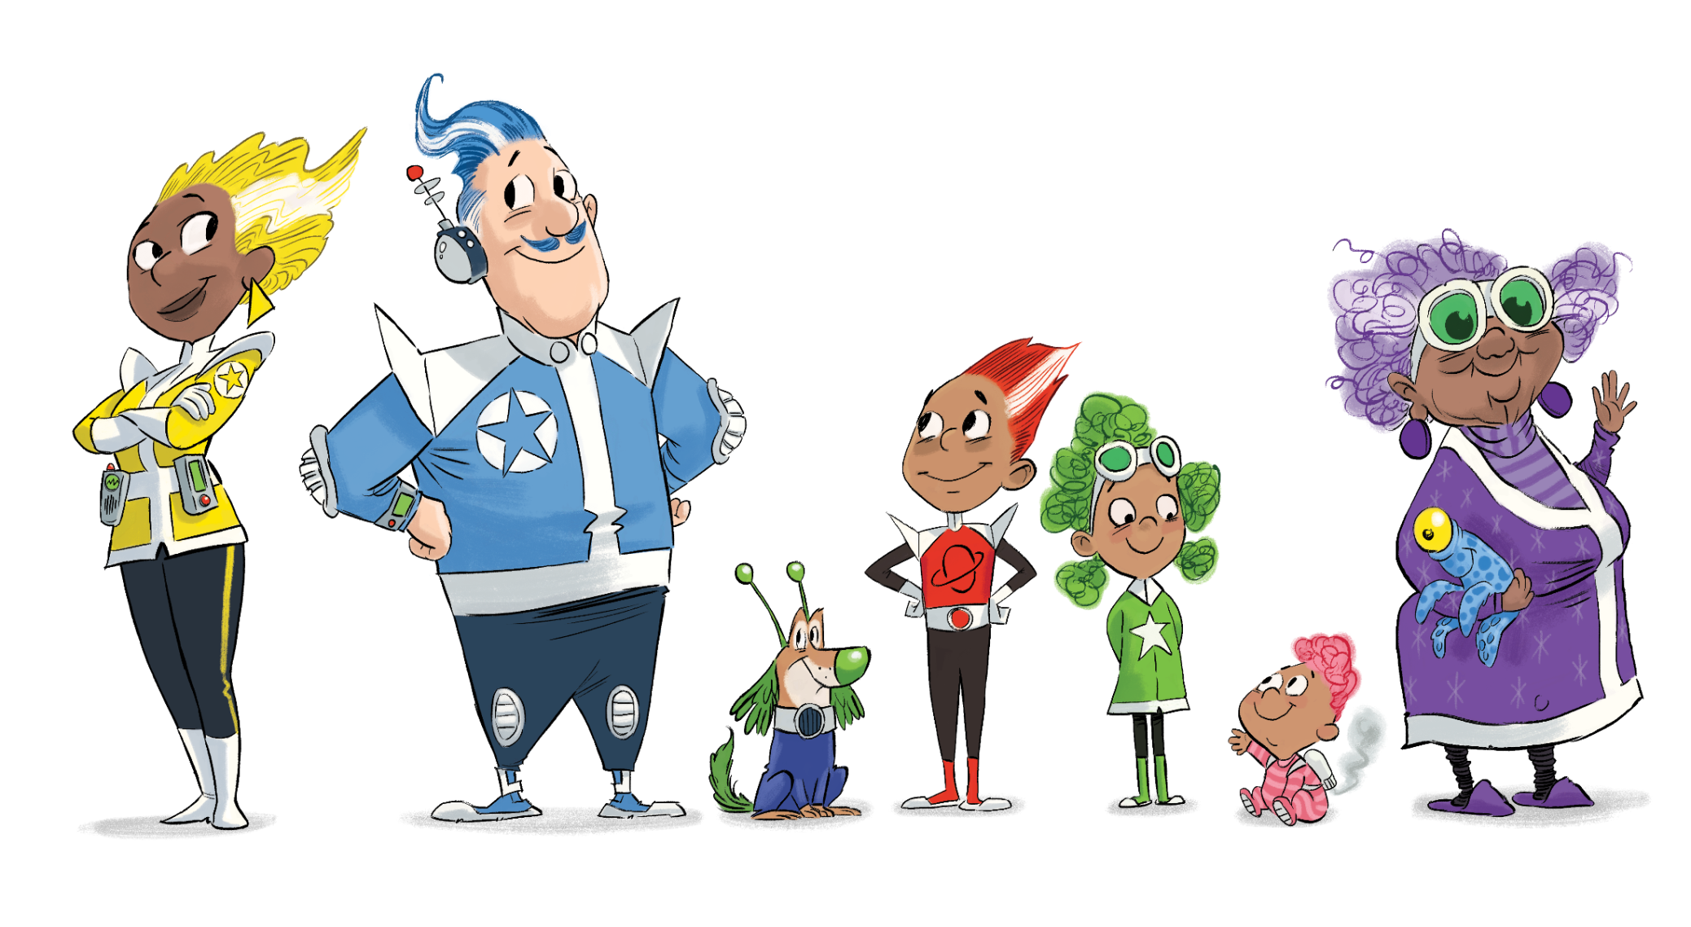
Notes:
Meet the Rockets! This super cool family lives on a satellite station in space. They love to spend time at their local library on the Moon.

Slide 3
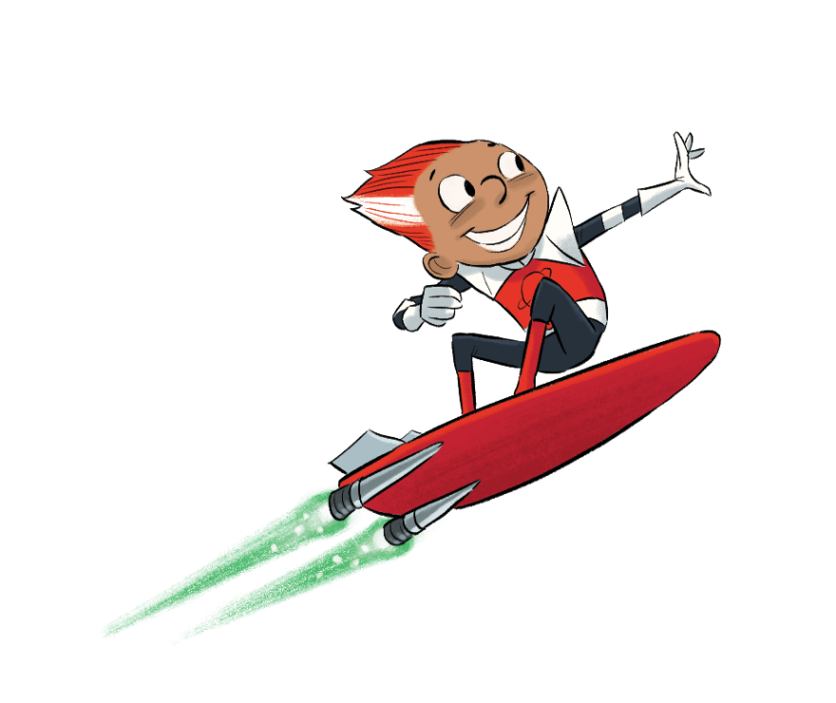
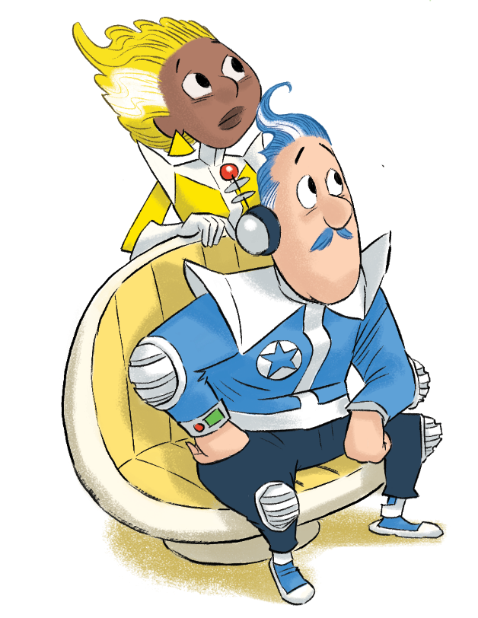
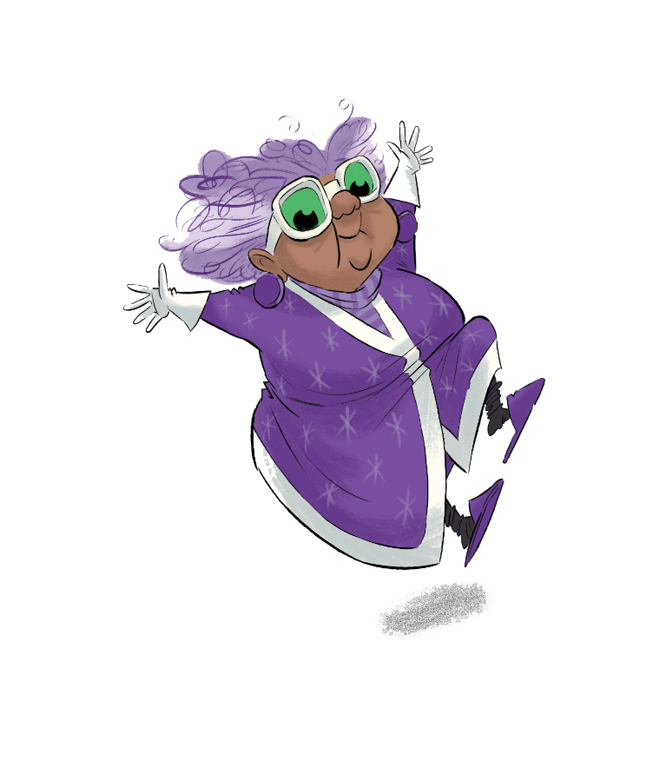
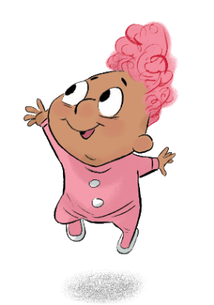
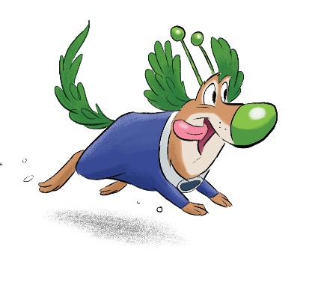
Notes:
This summer the Rockets are going on a very special mission, and they need your help!
Books are disappearing from the Moon Library with no explanation, and soon there won’t be any left!
Who could be behind such a dastardly deed…?
Could it be…

Slide 4
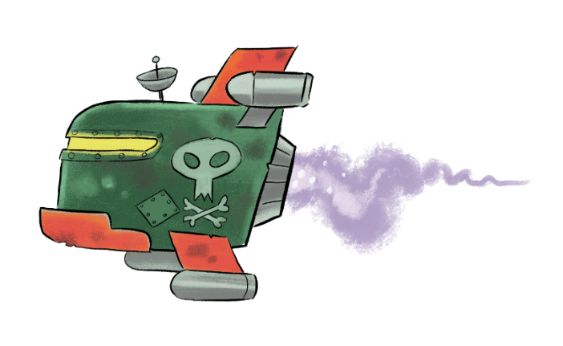
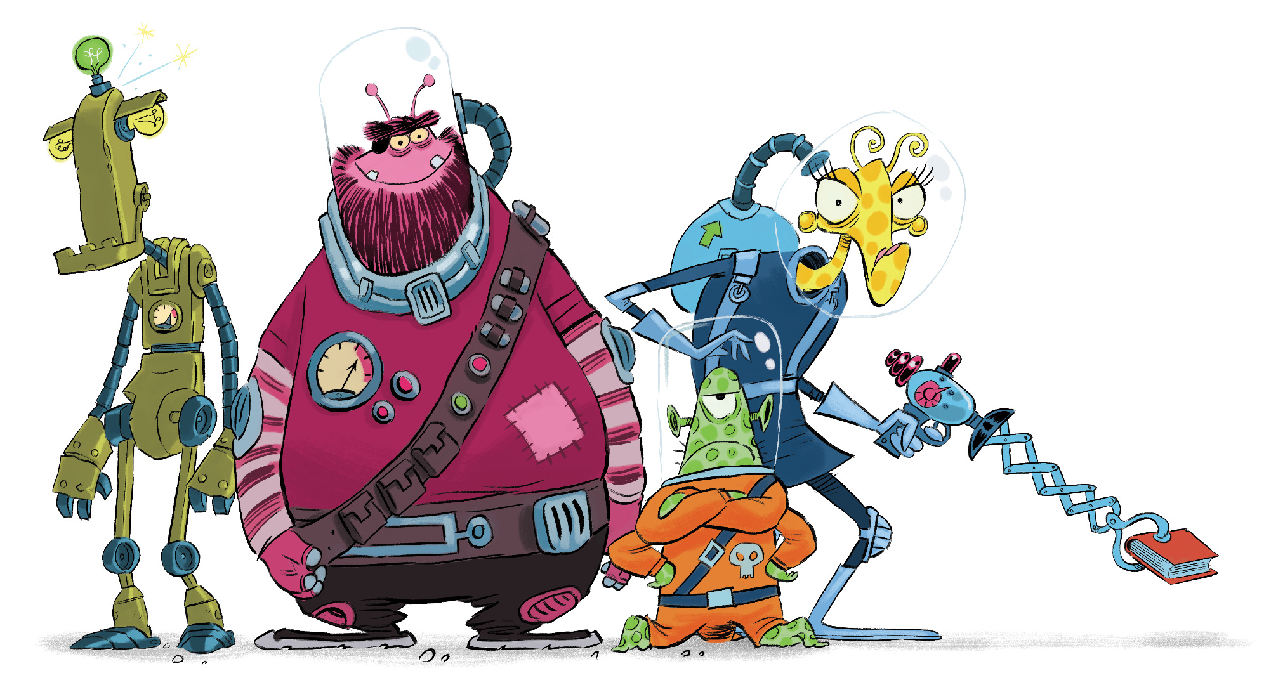
Notes:
Aliens! This naughty crew of alien adventurers want to keep all the books for themselves. Can you help the Rockets find them before it’s too late?
Watch out – they’re on the move! The Space Chase is on!

Slide 5
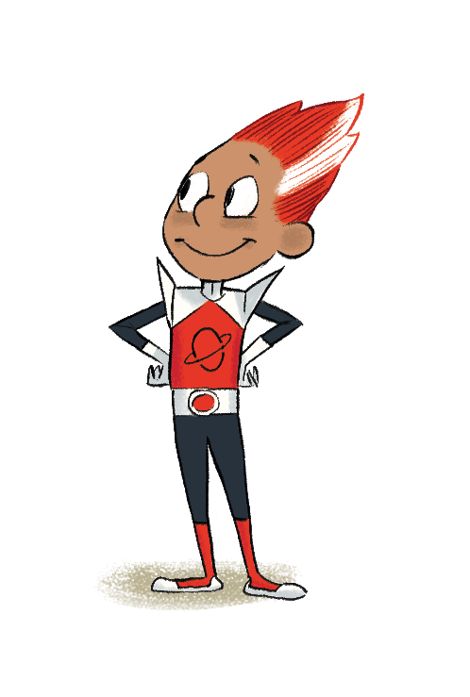
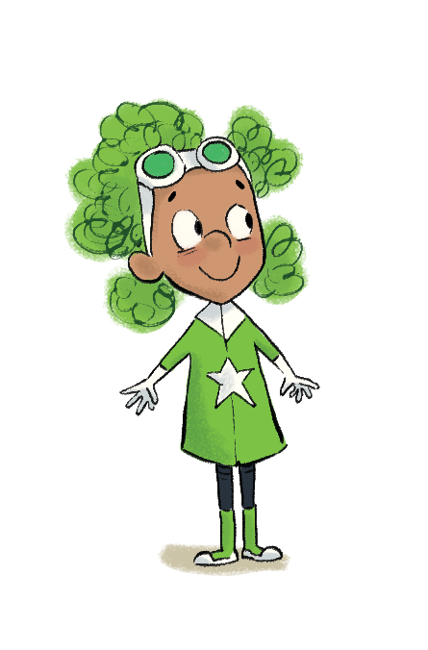
Join the Rockets for a
Summer Reading Challenge adventure in space!
Notes:
When you join the Summer Reading Challenge at the library, you’ll receive your very own collector folder to keep track of your Space Chase mission.
Each time you read a library book for the Challenge, you’ll get one step closer to finding the aliens and the missing books. Can you help the Rockets save the Moon Library and get home safely?
Watch out – space is full of all sorts of weird and wonderful things!

Slide 6
Go to your library this summer to join the Challenge – IT’S FREE!
Sign up to receive your special Space Chase mission folder
Read at least SIX library books over the holidays
Collect stickers for each book you read
Add the stickers to your folder to complete your mission and the Challenge!

Slide 7
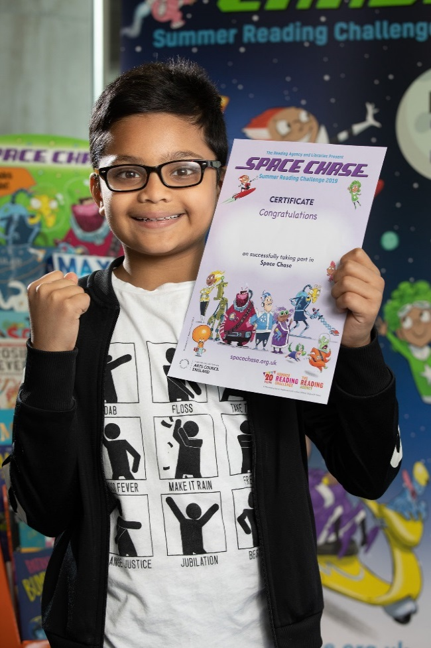
Complete the Challenge and you’ll get your own certificate
Notes:
Most library authorities will also give medals to children who complete the Challenge, but not all. Please check with your local library service.
You may wish to update this slide with the alternative medal reward photo included in the download.

Slide 8
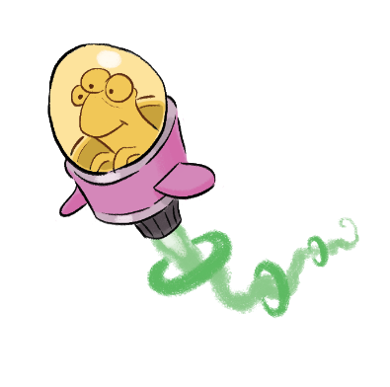
Take part this summer
All Warwickshire Libraries
Starts: Saturday 13th July
Ends: Friday 6th September
Notes:
Are you ready to start the Space Chase?

Slide 9
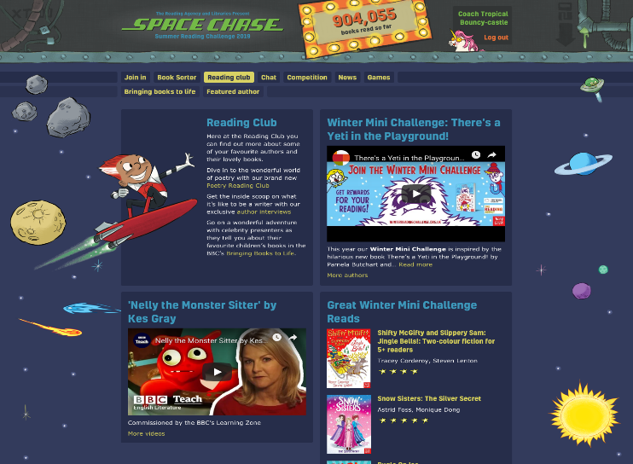
Visit the website
Rate and review your books to unlock badges
Play games and enter competitions
Enter the codes printed on your stickers to unlock extra rewards
Use the Book Sorter to find books recommended by other children
Notes:
The fun continues at home too! Visit the Space Chase website to play games, review your latest reads and enter competitions to win amazing Summer Reading Challenge prizes. You can share your favourite books with other children taking part in the Challenge and even unlock extra rewards for your reading.

Slide 10
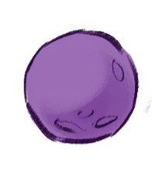
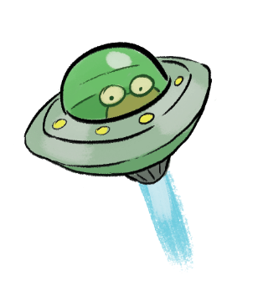
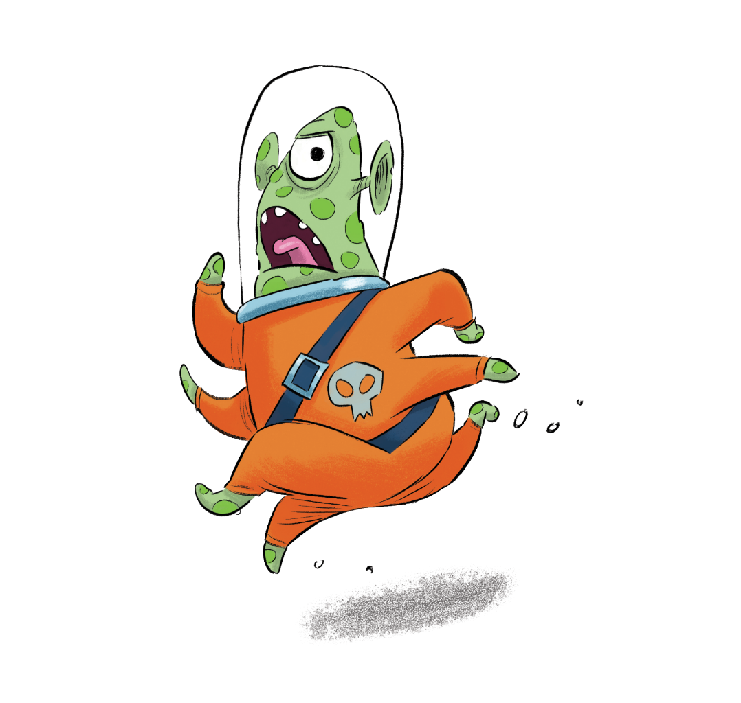
See you at
the library!

