Slide 1
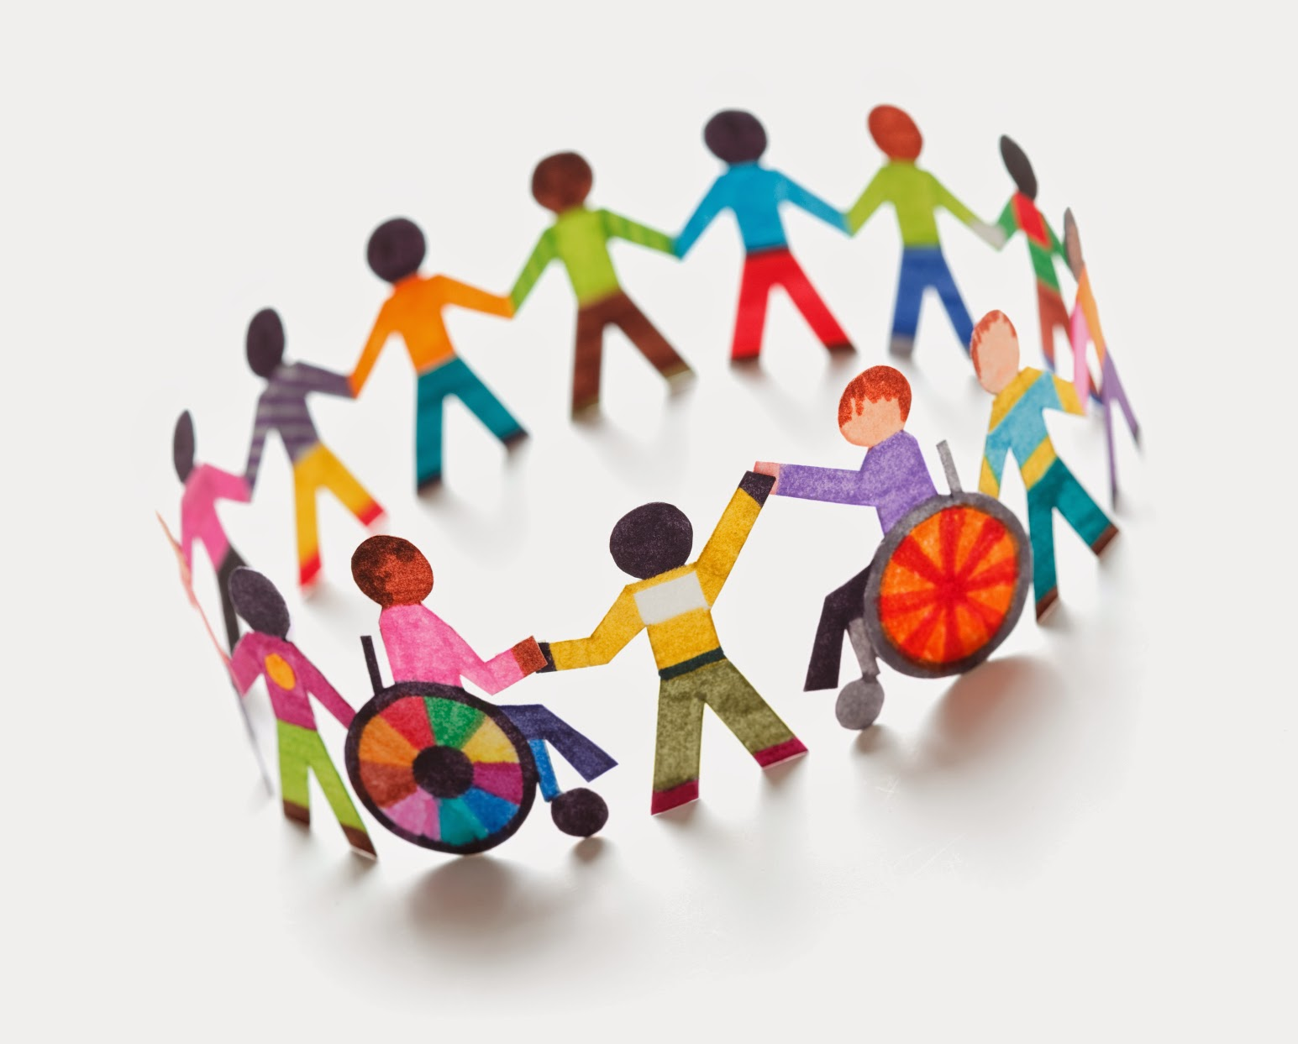
IMAGINATION SPACE WORKSHOP
Join our online workshop!
This is a great opportunity to share your views.
Warwickshire County Council need your ideas and stories to help design a new disability service.
Do you live in Warwickshire?
Date and Time:
28 September 2021
5.30pm
Do you have a disability?
Do you help someone who has a disability?
Would you like to be a part of an exciting project?
To book a space or to ask questions about the workshop please email: rosie.thomas@peopletoo.co.uk
We will send you a link to the Teams workshop when you book your space.

