Slide 1
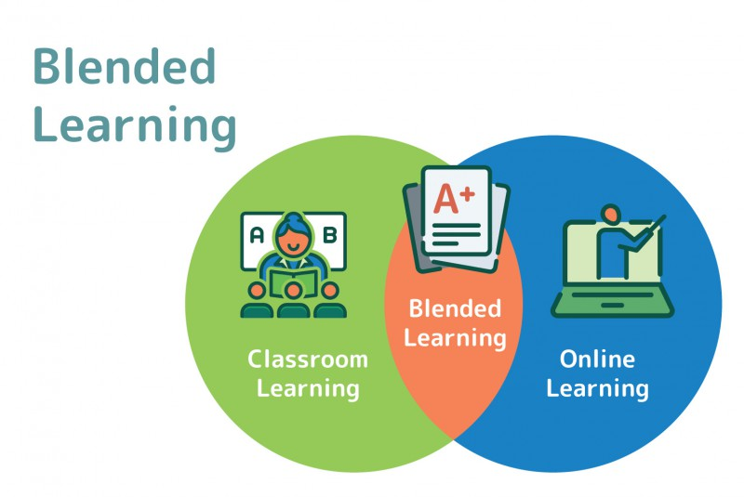
Consortia Project

Slide 2
PROJECT OBJECTIVES
To support and enhance the development and delivery of remote/blended learning opportunities for WCC schools that can be integrated into school curriculum planning
To demonstrate the benefits of remote learning not only in a home learning context but also to support and extend learning opportunities both in school and in blended learning scenarios
To promote the use of online tools that allow access to high-quality online and offline resources and teaching videos, consistently across schools in order to allow interaction, assessment and feedback
To deliver training to, and support through, the 14 WCC consortia and to develop systems within these consortia to share ideas and support, with a view to them becoming more self-sufficient

Slide 3
EXPECTED OUTCOMES
Creation of remote learning ‘expert users’ - one per consortium with 13 schools or below, two for those with 14 or above (nominations 23/10/20)
The expert users to be responsible for cascading training to the required lead staff from each school in their consortium group
For schools who have already started their remote/blended learning journey; to share their ideas, consolidate their practice and look for new opportunities; particularly in terms of the use or remote learning systems within school
For schools who have not previously used remote or blended learning; to select an appropriate delivery model, plan for its implementation, train staff, trial and develop their ideas with pupils and develop their confidence in using the available technologies

Slide 4
INITIAL TRAINING (to be completed by 12/2020)
Four remote twilight training sessions to be offered to all consortia schools (ICT + SLT leads in each school);
Using digital teaching to improve learning
Preparing your school for blended learning
Exploring options for blended learning
Considering online safety
Five remote daytime training sessions for identified consortia expert users;
Blended Learning using MS Teams
Blended Learning using Google Classroom
Blended Learning using Purple Mash
Recording and sharing video lessons
Monitoring an analysis of blended learning solutions

Slide 5
PROJECT APPROACH
ICTDS to provide initial training for all school leads, along with more in-depth training for one expert user in each consortia group
ICTDS to provide ongoing support for primary consortia expert users along with project coordination
Expert users to deliver support and training for schools within their consortium group
Expert user group meetings – to review progress and consider additional support requirements
Education Services to fund half a day per week between November and March

Slide 6
TRAINING DATES
All consortia schools:
20/10/20 - Using digital teaching to improve learning - 15.30 to 16.30
02/11/20 - Preparing your school for blended learning – 15.30 to 16.30
03/11/20 - Exploring options for blended learning – 15.30 to 16.30
09/11/20 - Considering online safety – 15.30 to 16.30
Expert Users:
02/11/20 - Blended Learning using MS Teams – 13.00 to 14.30
09/11/20 - Blended Learning using Google Classroom - 13.00 to 14.15
17/11/20 - Blended Learning using Purple Mash – 13.00 to 14.30
23/11/20 - Recording and sharing video lessons – 13.00 to 14.00
01/12/20 - Monitoring an analysis of blended learning solutions – 13.00 to 14.00

Slide 7
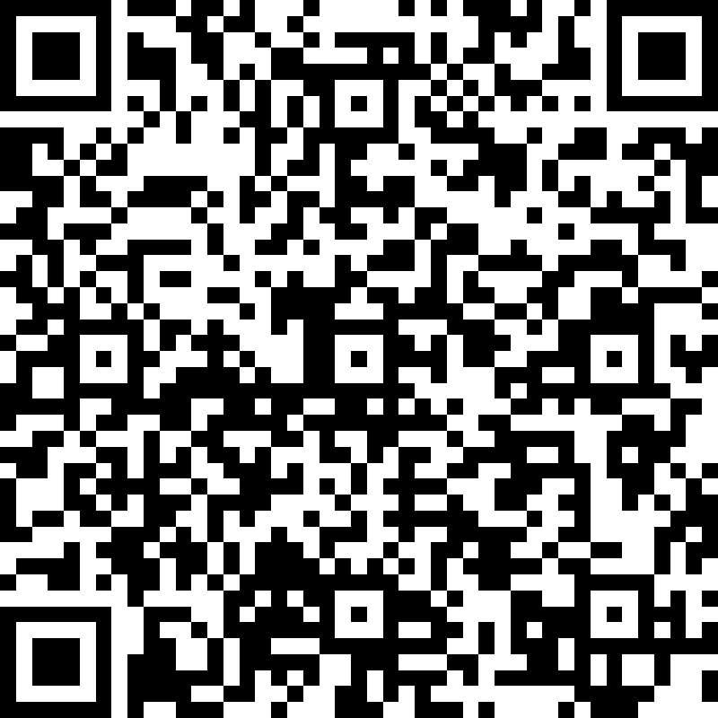
NOMINATION FORM
https://forms.office.com/Pages/ResponsePage.aspx?id=-hEVTLm6ekOhnanlPyn9sD1pFIphP1NDgHi3FUdWkA9UQkxMRloyVk9VWjlFN041N1Q5Q0czOFdUUC4u

