Slide 1
Working Together to Improve School Attendance. Think Attendance!
Sarah Tregaskis - Service Manager
Andy Danks – Delivery Lead
Notes:
Sarah

Slide 2
Think Attendance!
Data based on DfE Data (2021/22)
246 schools (not including registered alternative provision and independent schools)
75,735 pupils of compulsory school age (5-16) were enrolled at a Warwickshire schools (not including independent schools)
Warwickshire's pupil absence rate was 8.12%, this was higher than the national average at 7.55%
17,920 (23.66%) pupils of compulsory school age in Warwickshire were recorded as having attendance below 90% (Persistently Absent)
1,632 (2.15%) pupils of compulsory school age in Warwickshire had attendance of 50% or lower (Severely Absent)
Warwickshire Attendance Service – currently have 8 FTE Education Casework Officers (delivering traded and statutory functions), however this will increase to 12.8 FTE. This is to ensure we can meet the new requirements

Slide 3
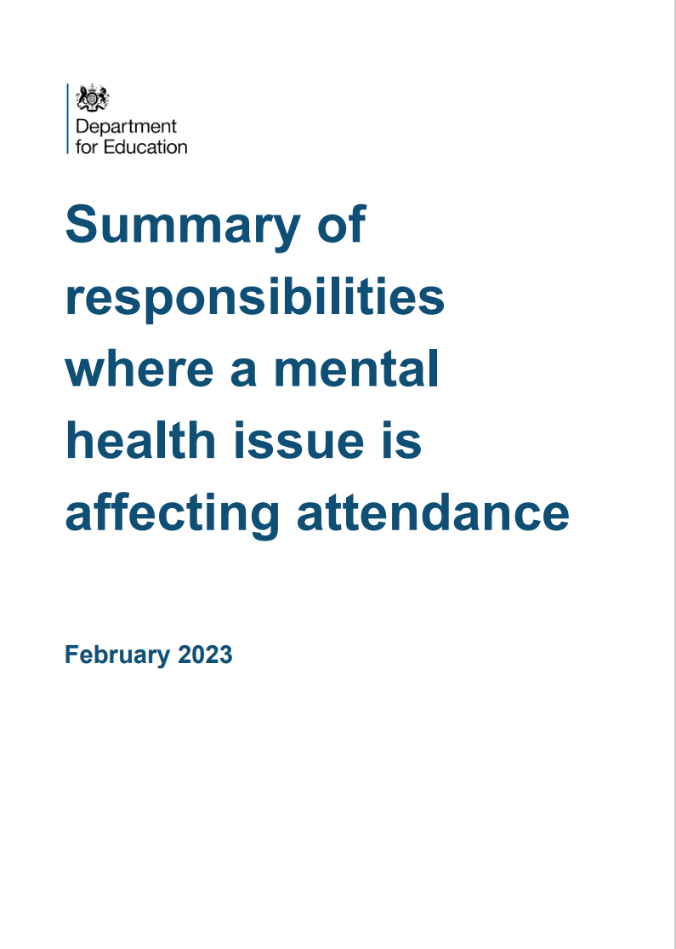
Working Together to Improve School Attendance.
On 6 May 2022, the Department for Education released new guidance to help maintain high levels of school attendance and improve consistency of support
Following this, several key pieces of guidance have been published that reference how improving school attendance is everybody's responsibility

Slide 4
Key changes:
1. Clarity of expectation: schools and local authorities will all have clearly defined statutory roles for the first time.
2. Earlier intervention: Schools will have legal responsibilities to proactively improve attendance for the first time (beyond existing requirements to record accurately).
3. Support first: All pupils and parents no matter where they live in the country will have clear expectations from their school, be informed about their child’s attendance and have access to early intervention and support first before any legal action if it becomes problematic.
4. Targeted whole family support: Attendance teams in LAs will work in tandem with early help to provide a whole-family response with a single assessment, plan and lead practitioner.

Slide 5
Expectation of schools
Work with local partners to remove out of school barriers and act as the lead professional where they are the best placed service
Work jointly with the local authority on an agreed approach/ plan for every severely absent pupil
Inform a pupil’s social worker if they have an unexplained absence or leave the school roll
Work with their LA to formalise support where voluntary help hasn’t been effective, through use of parenting contracts or other forms of legal intervention

Slide 6
Key changes Schools:
Have a Senior Attendance Champion on the leadership team
Have a clear school attendance policy published on their website
Have robust day to day processes for recording, monitoring and following up attendance
Analyse their data regularly and prioritise families to work with to understand and address the reasons for absence, including any in-school barriers to attendance.
Work with local partners to remove out of school barriers and act as the lead professional where they are the best placed service
Work jointly with the local authority on an agreed approach/ plan for every severely absent pupil
Develop strategies for cohorts of pupils with poorer attendance than their peers (including groups of vulnerability)
Inform a pupil’s social worker if they have an unexplained absence or leave the school roll
Work with their LA to formalise support where voluntary help hasn’t been effective, through use of parenting contracts or other forms of legal intervention
Share data electronically with the department and continue to inform the LA of pupils not attending regularly or being added to or removed from the roll

Slide 7
LA’s roles and responsibilities:
Makes attendance a key feature of all frontline council services, but especially access to education services, early help, statutory social care, and the Virtual School.
Build strong relationships with a range of services to help with specific barriers to attendance.
Work jointly with all local partners to offer multi-agency support (building on the existing early help offer) to families and pupils who need it.
Devise a strategic approach to attendance.
Rigorously track local attendance data (new DfE system called WONDE)
Build effective data sharing opportunities with different partners as part of the overall data sharing/ governance arrangements to ensure a joined-up approach

Slide 8
LA’s roles and responsibilities:
Have a School Attendance Support Team which provides the following core functions free of charge to all schools:
Communication and advice
Targeting Support Meetings
Multi-disciplinary support for families
Legal intervention: take forward attendance legal intervention (using the full range of parental responsibility measures) where voluntary support has not been successful or engaged with.
WCC's Attendance Team will carry out these functions: From April 2023:
18.75 FTE made up of: 12.8 FTE Education Caseworker Officers and 3.0 FTE Audit and Compliance
Officers, 2.95 FTE management roles.
Rather than holding significant numbers of cases, the School Attendance Support Team should support and advise the family’s lead practitioner on any attendance related elements of the plan, be part of the team around the family if necessary, and step in to lead any formal support or legal intervention when required.

Slide 9
Warwickshire’s Children
We have a shared interest in improving the outcomes for children in Warwickshire, including improving their school attendance
‘Working together to improve school attendance’ shares the same values as Child Friendly Warwickshire and the School’s Inclusion Charter
We are all on a journey of learning and change, we want to work collaboratively with you as we all go along

Slide 10
Next Steps:
“Our approach on attendance is: support first, support second, support third, with enforcement very much down the line.”
Baroness Barran, The Parliamentary Under-Secretary of State for Education- 22nd June 2022
Keep in contact, advise us of good practice
Regular updates are available in Heads Up
Questions and Suggestions
Email: WAS@warwickshire.gov.uk

